Slide 1

HIT Analysis

Slide 2
Agenda
Design Overview
Solution Design
Technical Design
Technical Implementations
Resources
Platform & Tools setup
Analytics
Analysis & Findings
Conclusion
Q&A

Slide 3
Solution Design
Design: Dataware house with 3 layer approach (Stage, DWH/DM & Pub)
Modelling: Kimball dimensional data model
Tool choices
DWH database storage/compute: Snowflake
Ingestion/Extraction: out of scope (but used DBT seed to ingest 2 sample files)
Transformation: DBT Core

Slide 4
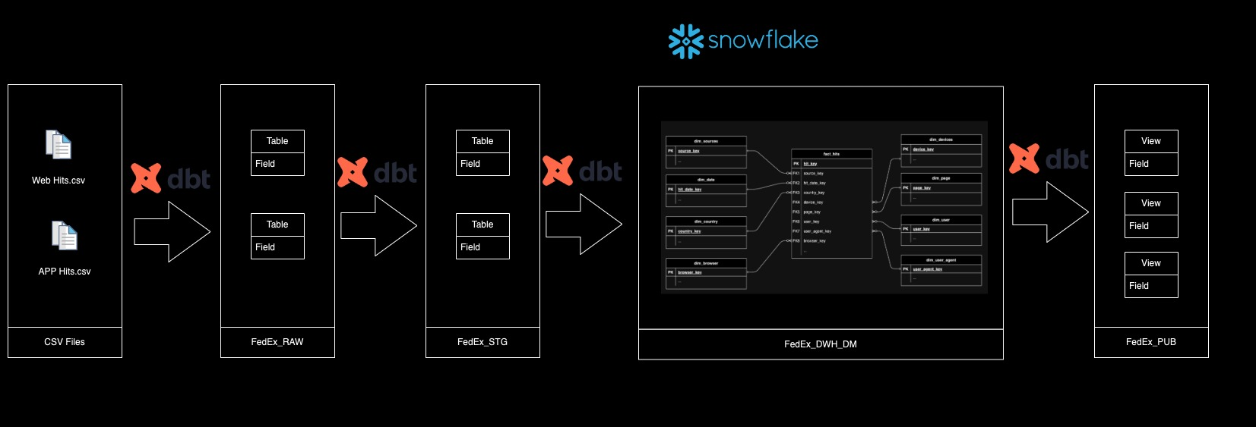
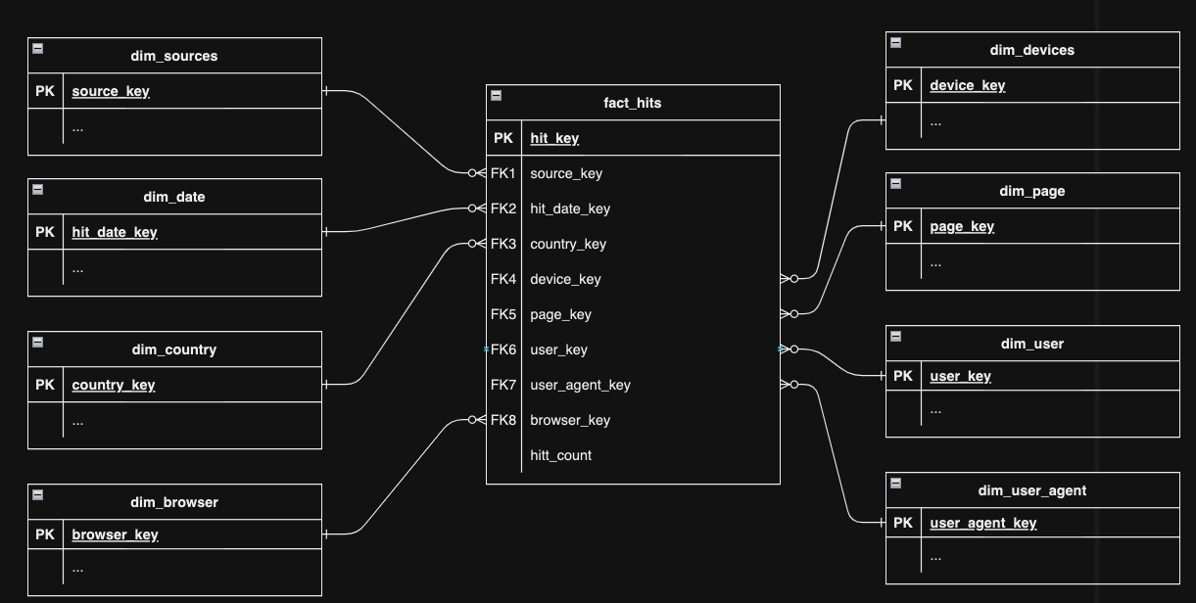
Technical Design
Design: Dataware house with 3 layer approach (Stage, DWH/DM & Pub)
Data Model:
Data Model: Link to GitHub

Slide 5
Resouces
Git Hub repo - https://github.com/vijay-palanisamy-1986/FedEx
Snowflake database details:
Portal link - https://app.snowflake.com/fbrbxlo/zq13195/#/homepage
Username: VijayPalanisamy
Password: 5XJrWiy5SeY-7-a
DBT Snowflake connection profile file: https://github.com/vijay-palanisamy-1986/FedEx/blob/main/_assignment/profiles.yml

Slide 6
DBT & Snowflake Setup
DBT Project & Folders
DBT Models
Seeds (Source/RAW)
Stage Models
DWH Models
Pub Models
Macros for common logics
DBT Tests
Technical tests by defining in *.yml file (schema folder)
Functional tests as dbt test models
Snowflake
Database & Schema (for each layers)
Tables, Type of Load and Views

Slide 7
Goal, Assumptions & Limitations
Goals
How to focus/motivate customers to move/use mobile app rather than website
Insights for Campaign to address non-app (website) users/hits
Assumptions
Focused only Data solution design, DBT tool, Analytics & presentation skills
Limitations
Limited dataset (1 APP and 1 Web HITs data) with limited period like 5 or 7 days
Dataset has only 1 country USA, which limits Geo level analytics
Dataset has only User_Id not other properties, which limited to do User analytics

Slide 8

Analysis & Findings - 01 (Web)
47.24%
18% iPhone users uses Web instead of App (Quick win)
10% Mac based machines (Quick win)
56% Windows based machines
14% Linux based machines

Slide 9

Analysis & Findings - 02 (App)
52,76%
74.89% FedEx App Hits orignated from iPhone
25% FedEx App Hits orignated from Android

Slide 10

Analysis & Findings - 03 (Web)
47.24%
75% Web HITs are done via Google Crome browser
Chrome has Notificaiton - Optimise FedEx Website for same

Slide 11

Analysis & Findings - 04 (Web)
47.24%
69% Tracking (Quick win)
9% Shipment/Delivery
6% Home page
4% Login/logout (Quick win by saved login)

Slide 12
Analysis & Findings - 05 (Web & App)

Slide 13
Conclusion
Focus on iPhone users to install & use FedEx-App instead of FedEx-Web in browser
Optimize FedEx-App for Mac machines, which enables Mac users to move away from FedEx-Web (safari) browsers
Focus on building FedEx-App for Windows (phone, tab & laptop) users, which enables Windows users to move away from FedEx-Web i.e., Window browser/Chrome
Chrome web-browser has notification feature (if user is logged in). Optimize FebEx-Website for this feature
More compute resources for 2X to 4X increased demand in the weekend
Optimized/Streamlined (or even segregated FedEx app) for Tracking & Shipment

Slide 14
Q & A

